Slide 1

UNIVERSITY INSTITUTE OF ENGINEERING
COMPUTER SCIENCE ENGINEERING
Bachelor of Engineering (Computer Science & Engineering)
Subject Name: Blockchain Technology
Subject Code: 20_CST-412
Need for Distributed Record Keeping
Mapped with CO2
Prepared By:
Er. Ankita Sharma
DISCOVER . LEARN . EMPOWER

Slide 2
Outline
Definition
Need of Block chain
Need for Distributed Record Keeping
Byzantine Generals problem
Consensus algorithms and their scalability problems
Technologies Borrowed in Block chain – hash pointers

Slide 3
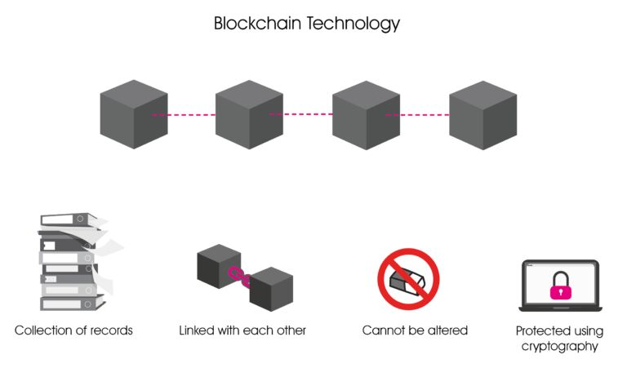
Definition
A blockchain is a –
Distributed database
Immutable records called blocks
Secured using cryptography
Stores data chronologically
Credit: www.ikigailaw.com

Slide 4
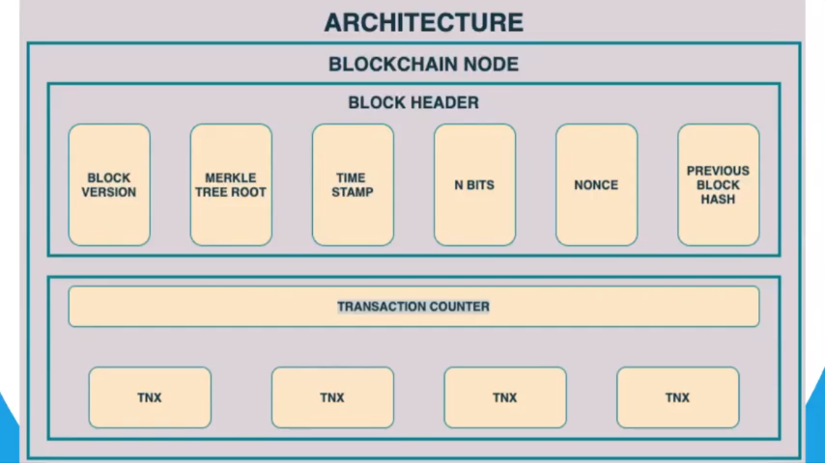
Architecture of a block

Slide 5
Data+Nonce ------→ hash algo -------→ Hash of block

Slide 6
Hash Root123
MERKLE TREE
SHA-256
Derterministic
One way
Collision free
Hello
Hello W
Hash12
Hash1
Hash2
Hash3
T1
T2
T3

Slide 7
Let's breakdown the definition,
Ledger: It is a file that is constantly growing.
Permanent: It means once the transaction goes inside a blockchain, you can put up it permanently in the ledger.
Secure: Block chain placed information in a secure way. It uses very advanced cryptography to make sure that the information is locked inside the blockchain.
Chronological: Chronological means every transaction happens after the previous one.
Immutable: It means as you build all the transaction onto the blockchain, this ledger can never be changed.

Slide 8
Need of Blockchain
Time reduction: In the financial industry, blockchain can allow the quicker settlement of trades. It does not take a lengthy process for verification, settlement, and clearance. It is because of a single version of agreed-upon data available between all stakeholders.
Unchangeable transactions: Blockchain register transactions in a chronological order which certifies the unalterability of all operations, means when a new block is added to the chain of ledgers, it cannot be removed or modified.
Reliability: Blockchain certifies and verifies the identities of each interested parties. This removes double records, reducing rates and accelerates transactions.

Slide 9
Security: Blockchain uses very advanced cryptography to make sure that the information is locked inside the blockchain. It uses Distributed Ledger Technology where each party holds a copy of the original chain, so the system remains operative, even the large number of other nodes fall.
Collaboration: It allows each party to transact directly with each other without requiring a third-party intermediary.
Decentralized: It is decentralized because there is no central authority supervising anything. There are standards rules on how every node exchanges the blockchain information. This method ensures that all transactions are validated, and all valid transactions are added one by one.

Slide 10
Need for Distributed Record Keeping
A distributed ledger is a type of database that is consensually shared, replicated, and synchronized among the members of a decentralized network.
OR
A distributed ledger is a database that is consensually shared and synchronized across multiple sites, institutions, or geographies, accessible by multiple people.
OR
A distributed ledger can be described as a ledger of any transactions or contracts maintained in decentralized form across different locations and people, eliminating the need for a central authority to keep a check against manipulation.

Slide 11
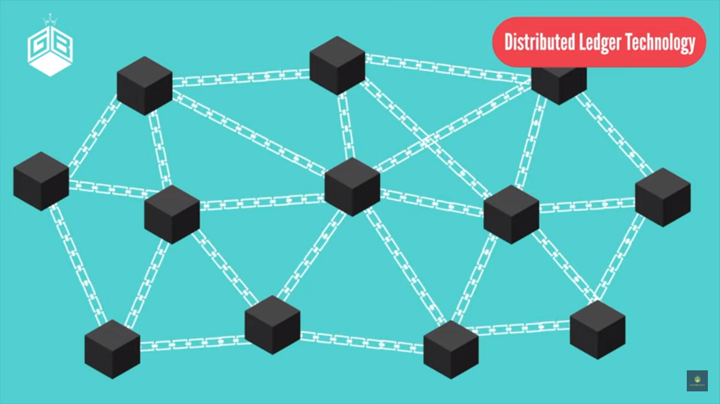

Slide 12
A centralized ledger is more prone to cyber attacks and fraud, as it has a single point of failure on the other hand distributed ledgers are inherently harder to attack because all of the distributed copies need to be attacked simultaneously for an attack to be successful.
By being difficult to manipulate and attack, distributed ledgers allow for extensive transparency.
The need for a central authority to keep a check against manipulation is eliminated by the use of a distributed ledger.
Distributed ledgers also reduce operational inefficiencies, speed up the amount of time a transaction takes to complete, and are automated, and therefore function 24/7, all of which reduce overall costs for the entities that use them.

